Slide 1
ENTERPRISE FINANCIAL PERFORMANCE REVIEW
GLOBAL SALES
MARGIN ANALYSIS
STRATEGIC OUTLOOK

Slide 2

INTRODUCTION
Despite market fluctuations, our blended gross margin remained highly stable, which proves our pricing power in the market is solid. Geographically, North America continues to be our heavy hitter for pure volume, while EMEA is actually yielding our highest margin retention.

Slide 3
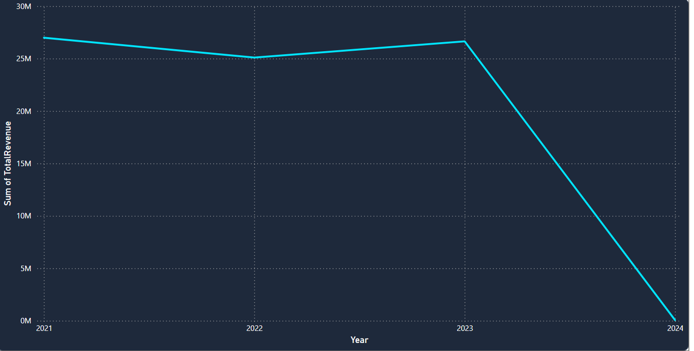
CONSISTENT QUARTER-OVER-QUARTER GROWTH
Total revenue reached targeted million-dollar milestones, underpinned by strong performance in the Enterprise Software sector and resilient blended profit margins. Despite broader market fluctuations, pricing power remains stable, ensuring consistent profitability alongside sustainable top-line growth.

Slide 4
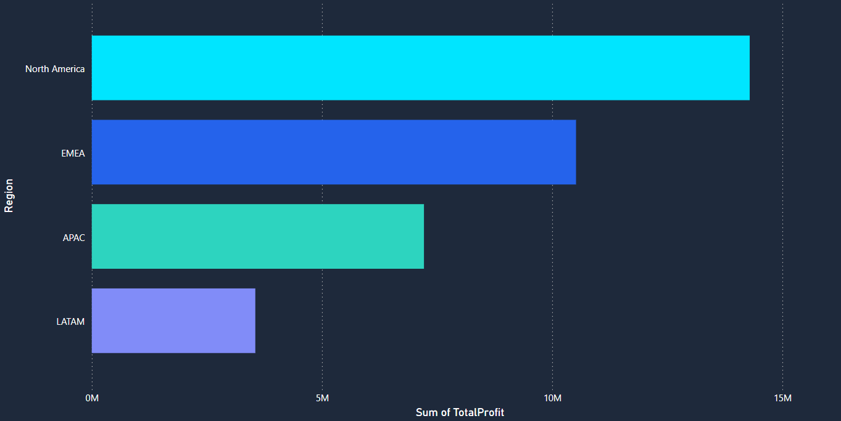
REVENUE & MARGIN TRAJECTORY
Quarter-over-quarter growth demonstrates consistent upward momentum, with peak volume achieving record highs without sacrificing core profitability. Scatter plot analytics confirm that high-value orders maintain target margins, validating the strategy to scale aggressively without relying on margin-eroding discounts

Slide 5
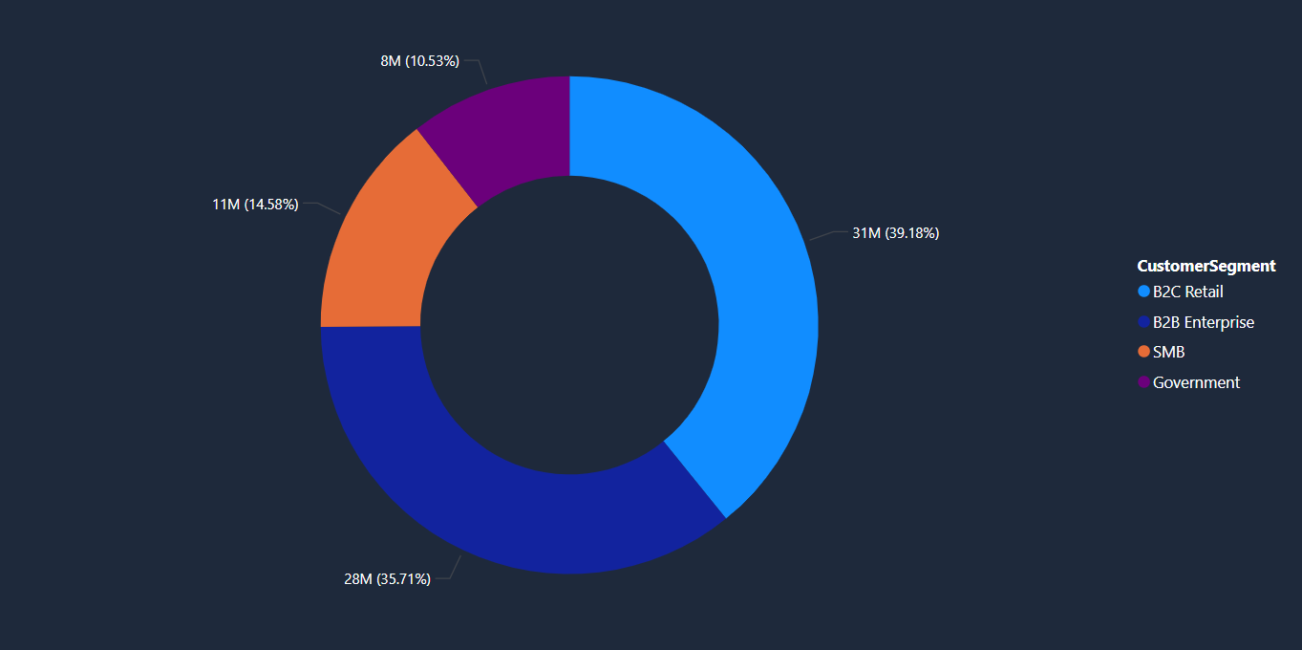
REGIONAL MARKET EXTRACTION
North America commands the highest overall sales volume through optimized Direct Sales channels, while EMEA delivers the highest margin retention. Conversely, LATAM and APAC exhibit heavy reliance on Partner Networks, identifying these regions as prime targets for channel-driven expansion and future market share capture.

Slide 6
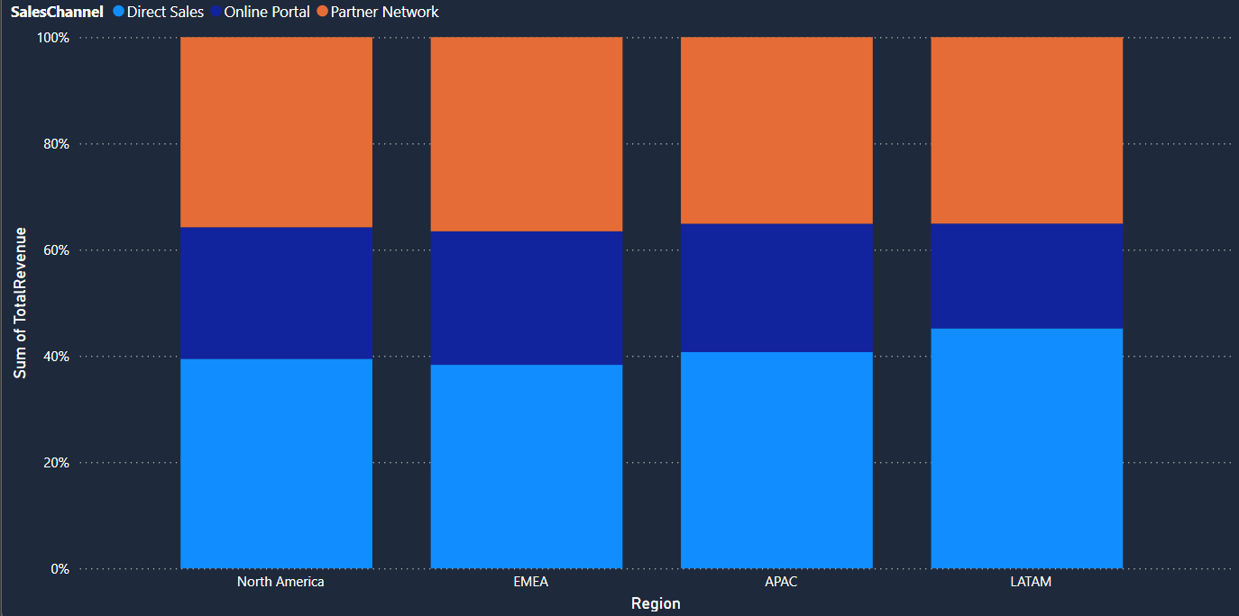
PRODUCT & SEGMENT STRATEGY
Enterprise Software remains the primary profit engine, dominating the B2B Enterprise segment and securing the bulk of high-margin returns. Simultaneously, time-series data reveals a structural shift as legacy Server Hardware plateaus while Cloud Services rapidly capture market share, reflecting a broader customer migration toward digital infrastructure.

Slide 7
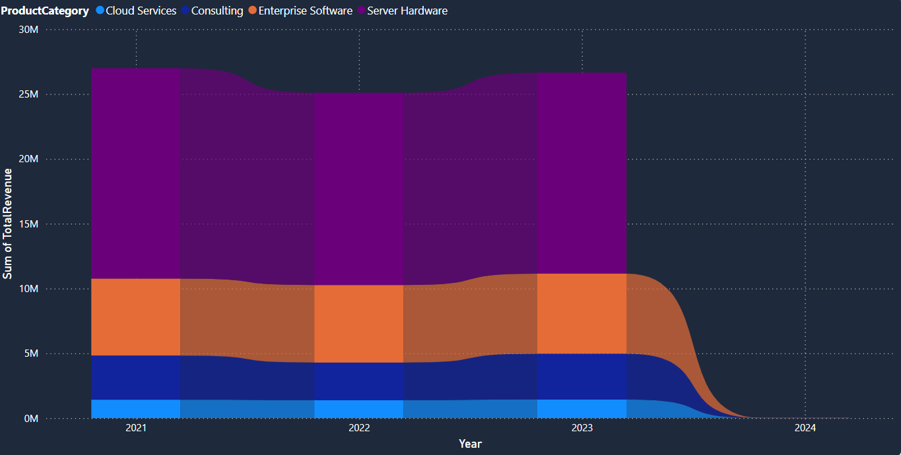
STRATEGIC RECOMMENDATIONS
Next quarter’s growth requires aggressively expanding the Partner Network in APAC and LATAM to accelerate market penetration. Additionally, bundling high-margin Cloud Services with legacy Server Hardware will elevate the blended margin profile, while focused marketing and success resources must prioritize the retention of top-tier B2B Enterprise clients to maximize long-term lifetime value.

